Slide 1
Planning Brain Demo
Agility
o9 PLATFORM | DEMO
2025

Slide 2

Current State
Response to a demand upside opportunity
o9 PLATFORM | DEMO
CURRENT STATE
Risk & opportunity information does not flow to the planning organization in time
Result is either lost opportunity or lower margin if the opportunity is taken up
Standard planning processes are too slow to respond
Financial trade offs unclear – We can get incremental revenue and margin, but at what incremental supply chain cost?

Slide 3
The Situation
o9 PLATFORM | DEMO
THE SITUATION
Pastry category planner is being alerted to a gap to Target and needs to quickly find opportunities and propose a plan to close the gap.

Slide 4
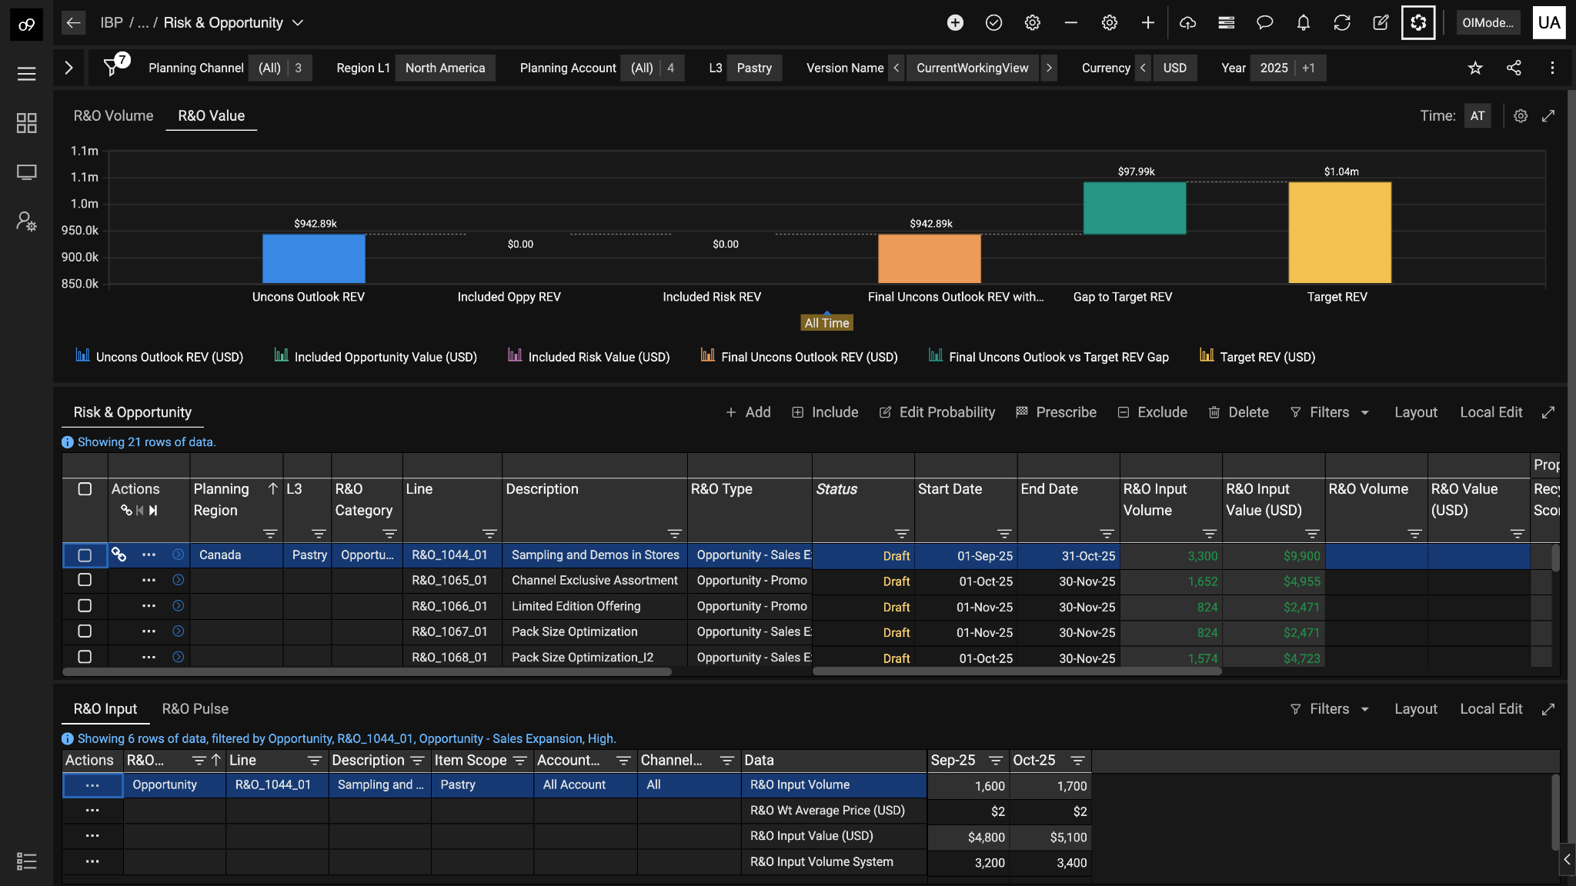
o9 PLATFORM | DEMO
R&Os
Planner reviews the already proposed structured R&Os for this category and realizes he needs some more proposals to help close the gap
o9’s EKG already enables structured R&Os workflows
R&O what-if analysis (CRUD, prescribe)
Collaborate on R&O probability, inclusion / exclusion criteria

Slide 5
Imagine
o9 PLATFORM | DEMO
SCENARIO
Instead of having to spend hours/days researching and corroborating information from a multitude of sources
To… having R&O agents not only analyzing all tribal unstructured knowledge sources within the enterprise and external internet sources but also recommending the most relevant ones for my products or regions

Slide 6
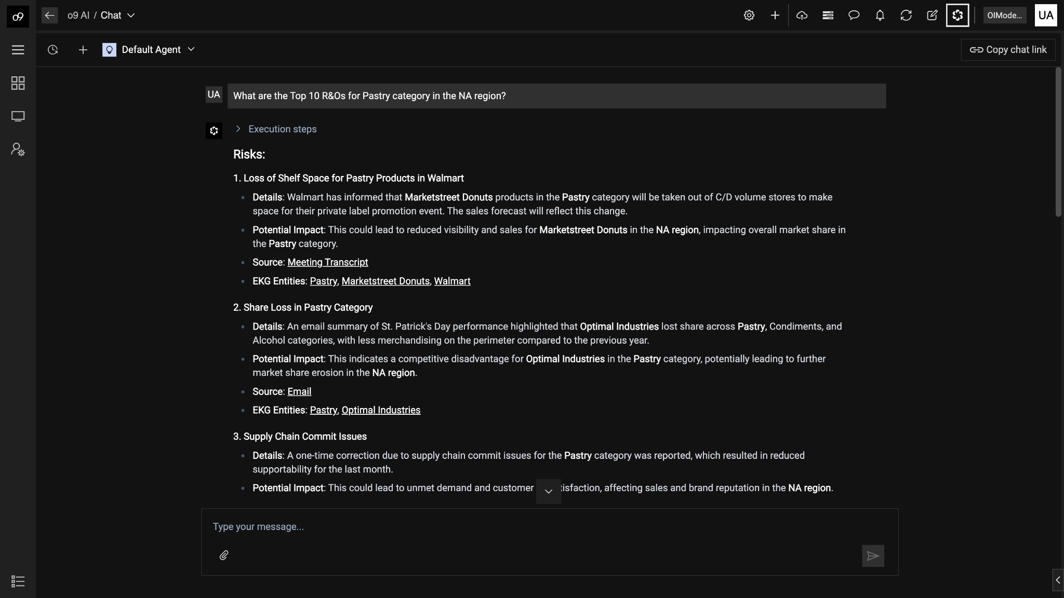
o9 PLATFORM | DEMO
Use the R&O agent to find the top 10 R&Os for Pastry category in the NA region (Default agent automatically routes this request to the R&O agent)
Automatically categorize into risks and opportunities
Leverage various tribal knowledge sources - Pulses, Emails, Meeting Transcripts, etc.
Also enable internet search for external knowledge sources
EKG aware entity tagging to ensure the R&Os are contextual to the scope requested

Slide 7
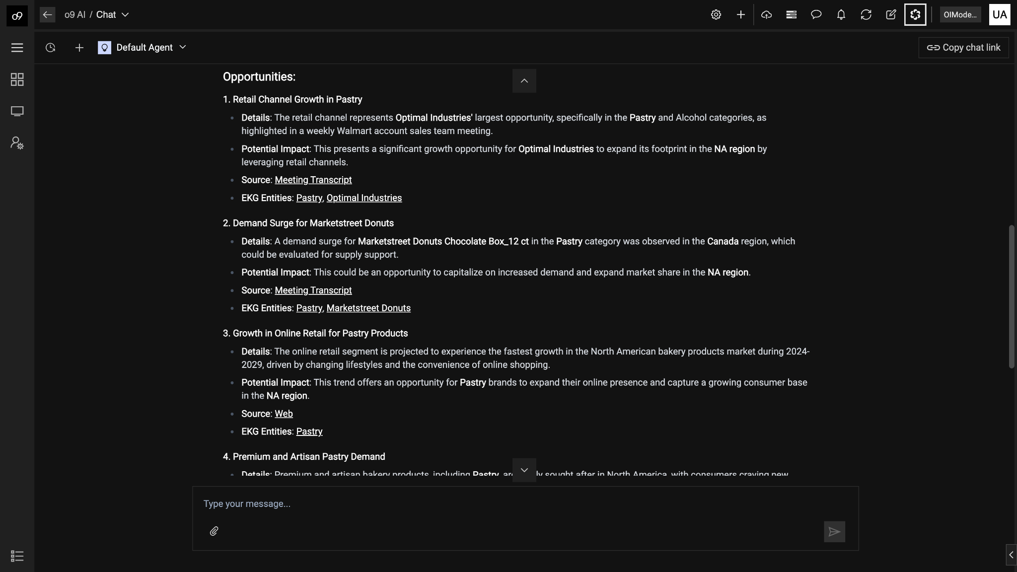
o9 PLATFORM | DEMO
Review the demand surge opportunity as a candidate to consider

Slide 8
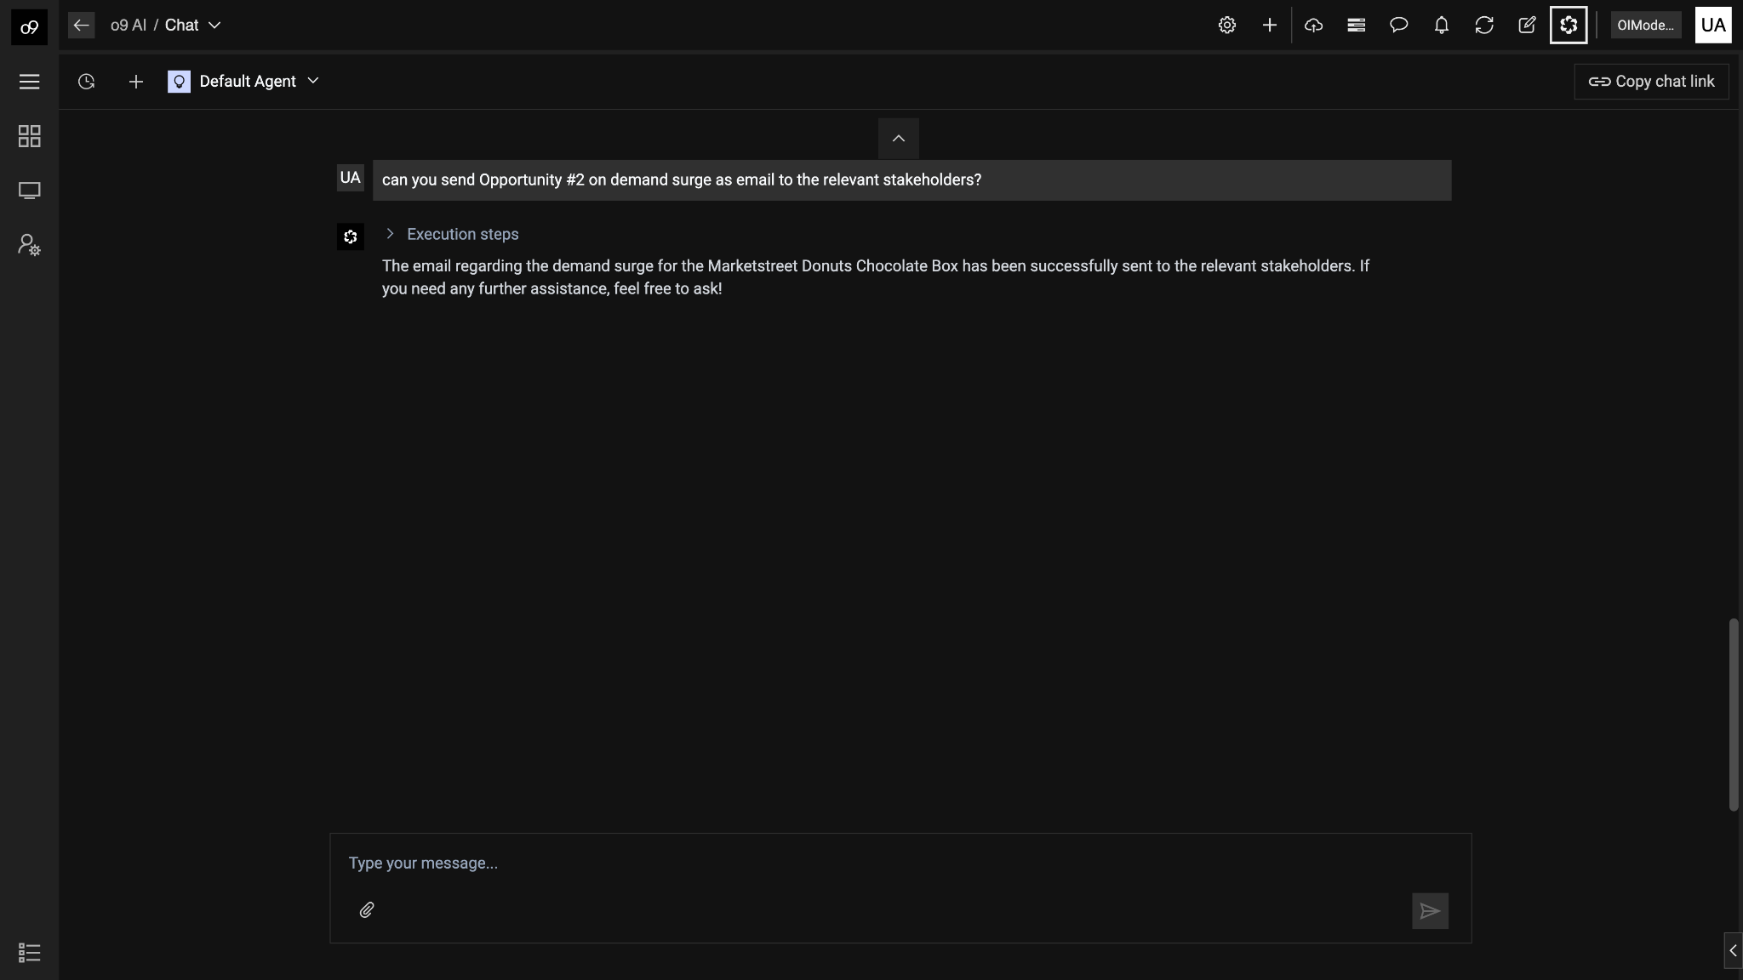
o9 PLATFORM | DEMO
Send the R&Os to the relevant stakeholders for collaboration
Integrated email agents to send R&Os to the inbox. Model knows who to send it to based on the context

Slide 9
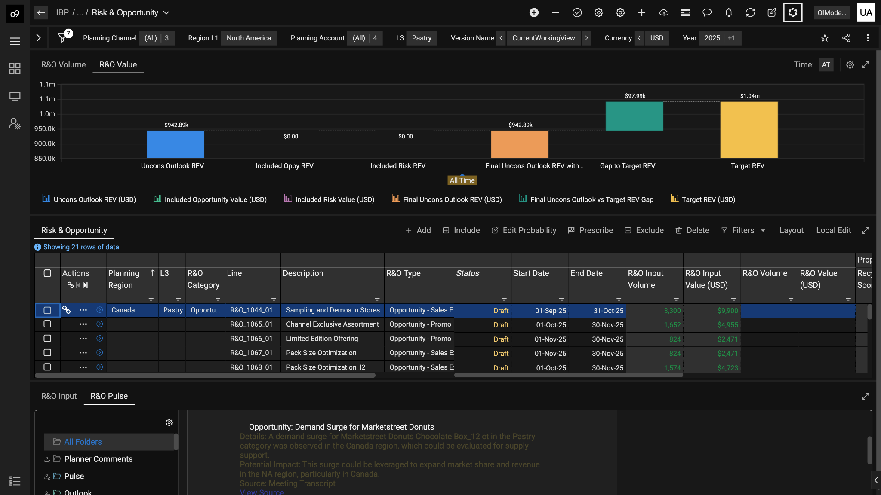
o9 PLATFORM | DEMO
Opportunity is contextually tagged and surfaced to the relevant users
Opportunity is tagged and available for the planner to collaborate and incorporate

Slide 10
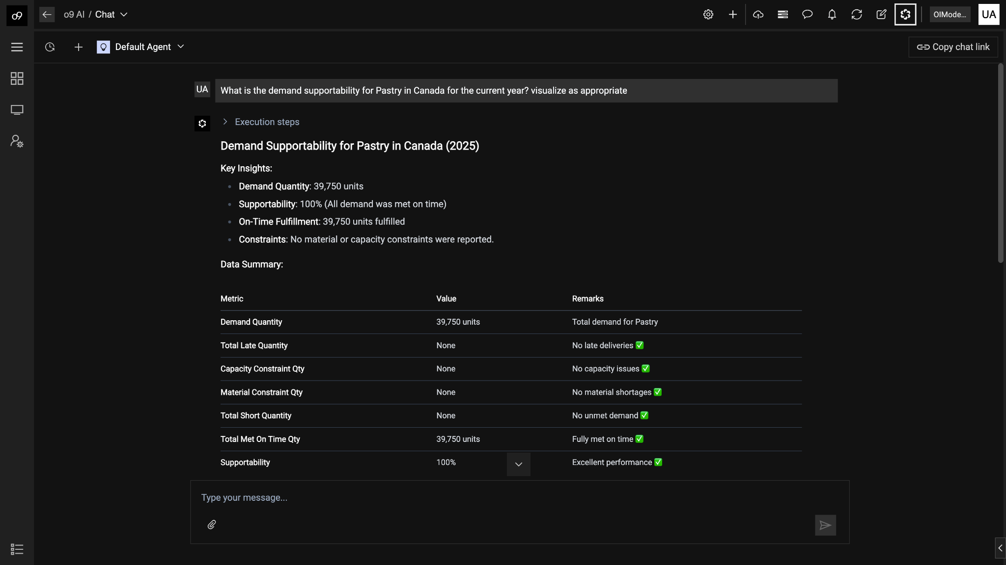
o9 PLATFORM | DEMO
Quick check to understand the current supply supportability for Pastry in the Canada region
EKG agent is able to get data and generate relevant summarization of the supply plan

Slide 11
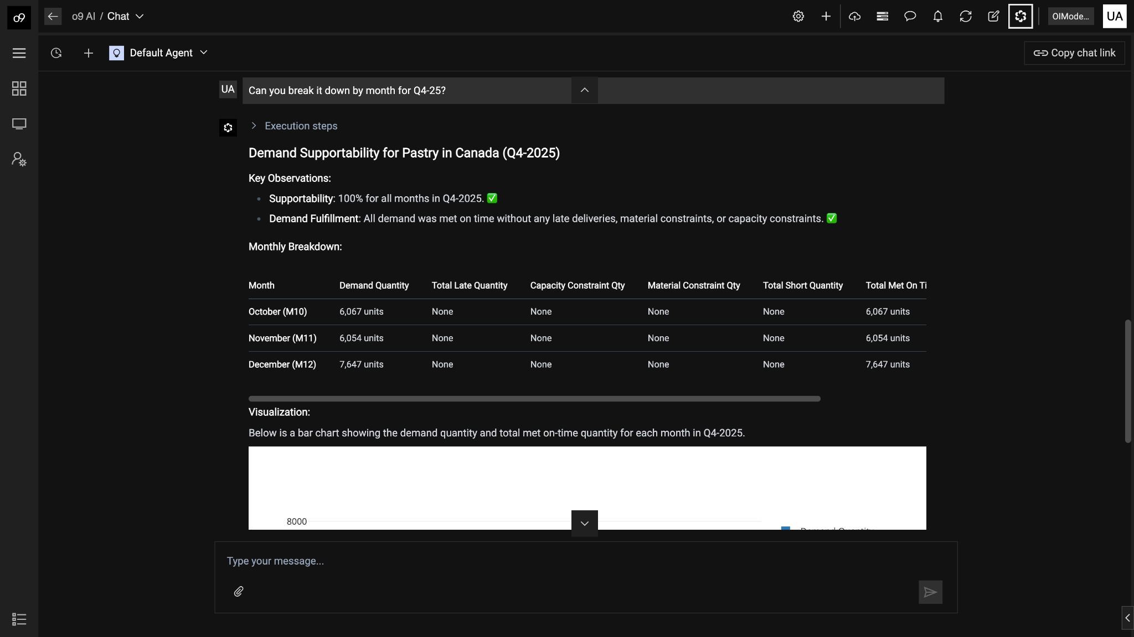
o9 PLATFORM | DEMO
Planner can continue the conversation context to get more detailed breakdown by month for the next quarter
EKG agent is retain memory of user conversation and continue the analysis

Slide 12
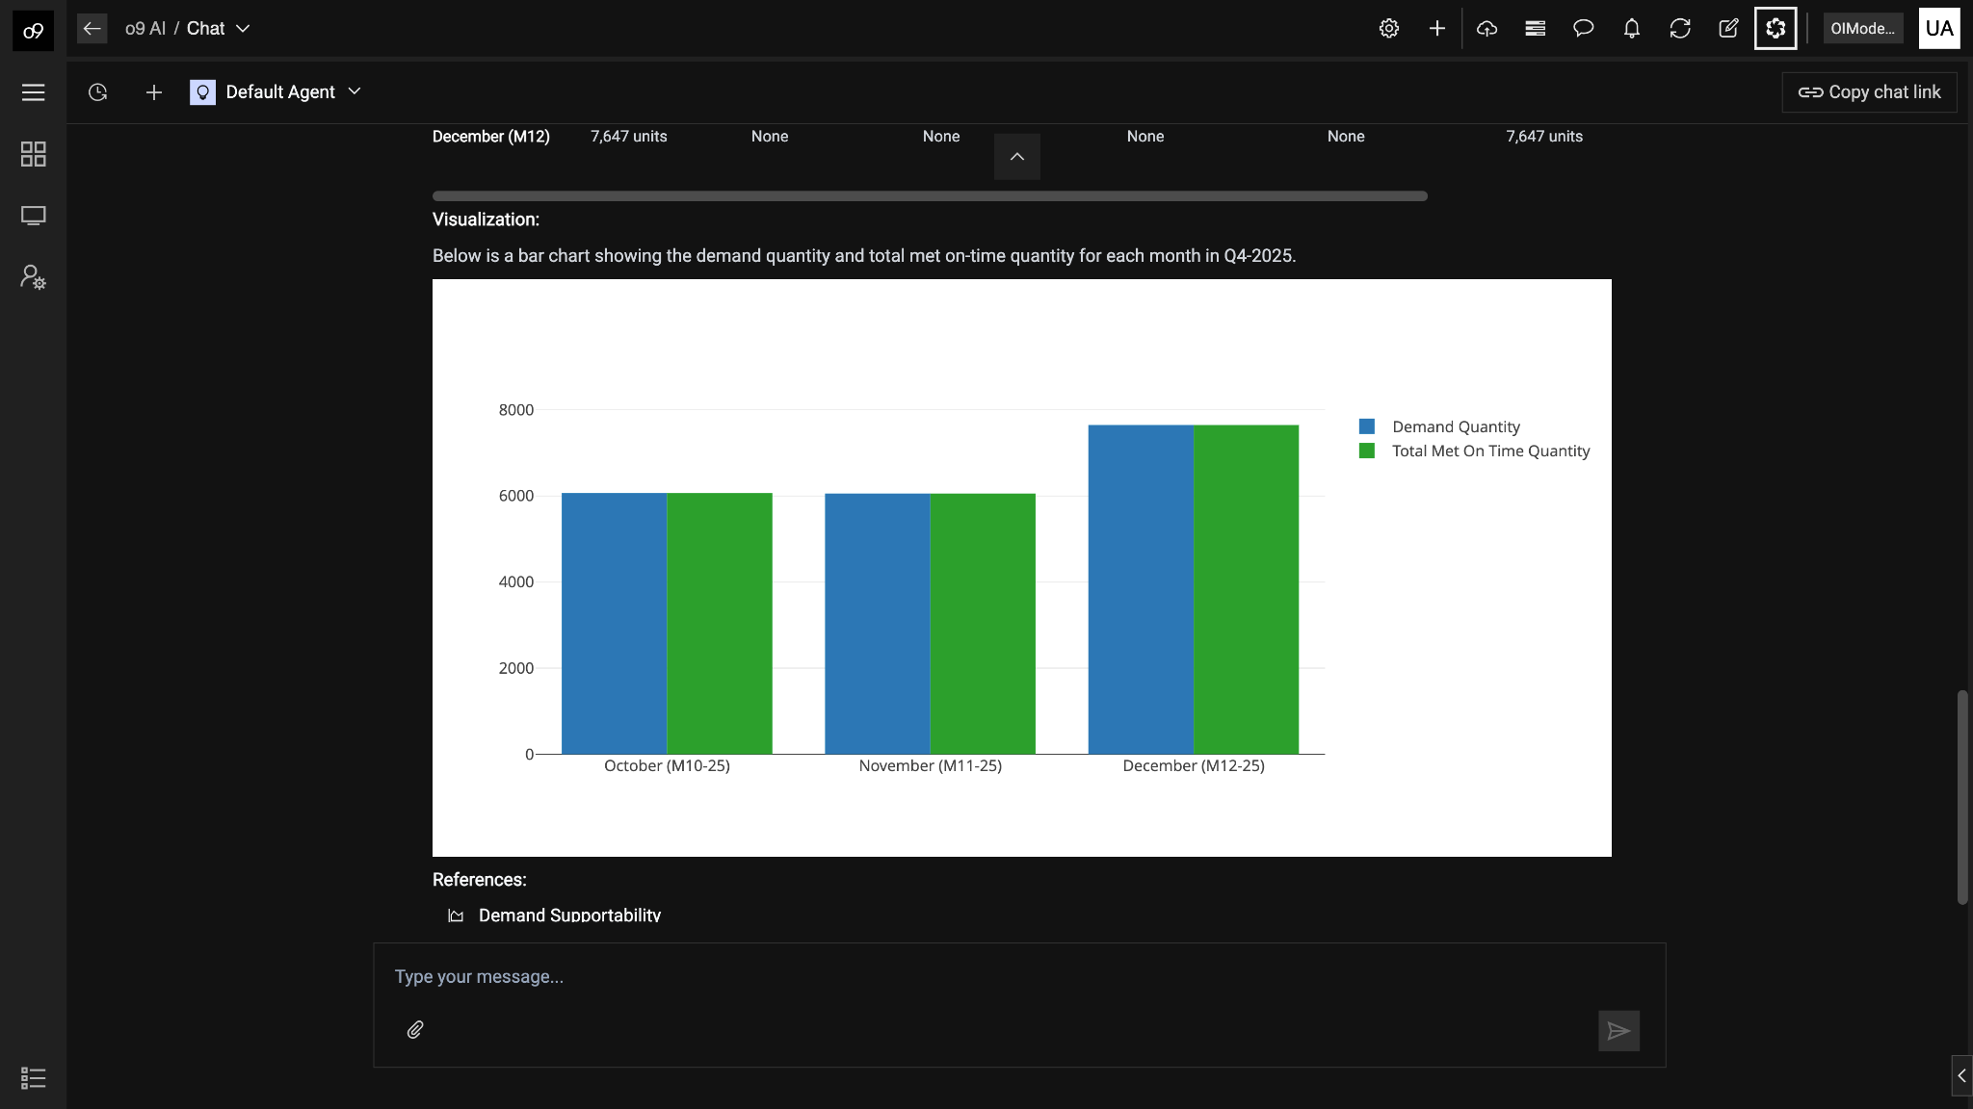
o9 PLATFORM | DEMO
Planner can continue the conversation context to get more detailed breakdown by month for the next quarter
Quick summarization of the plan analysis and visualization of the outputs

Slide 13
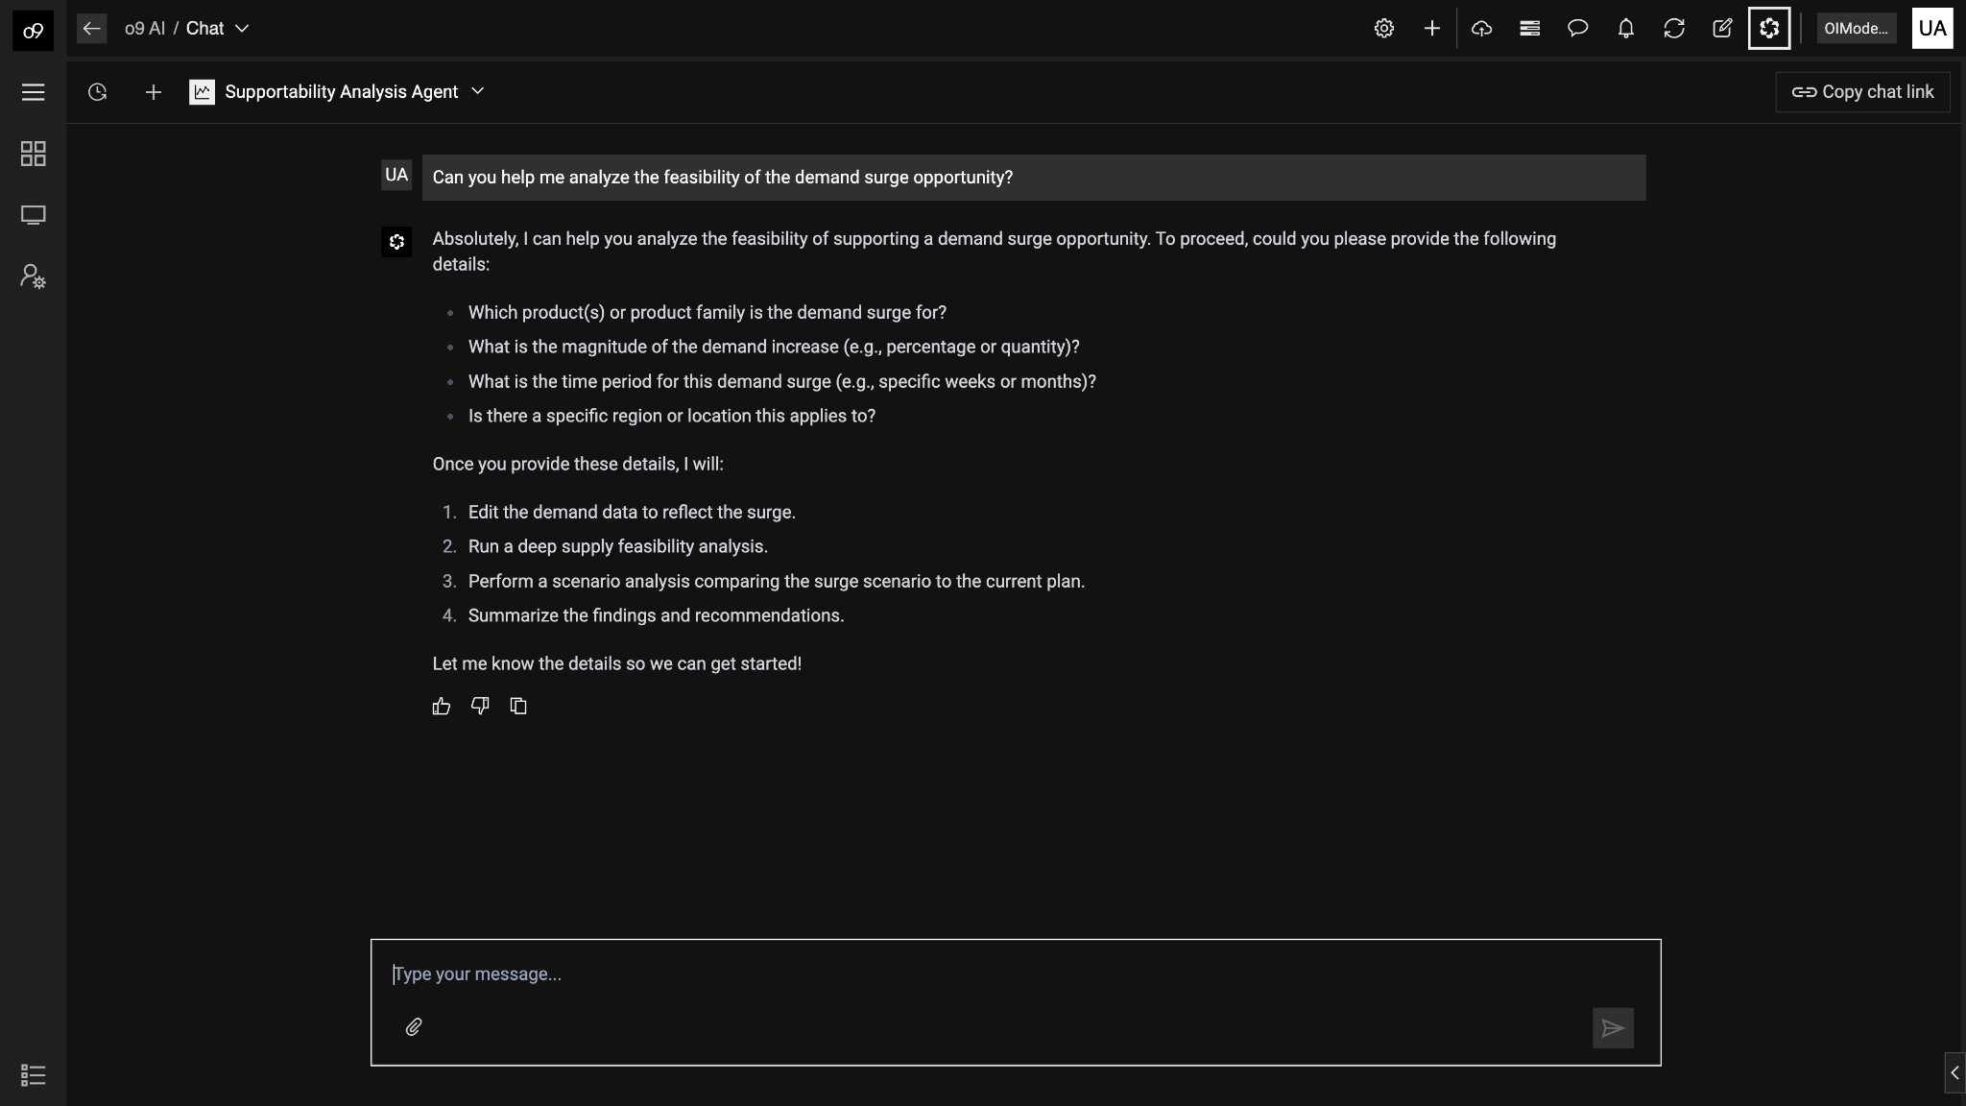
o9 PLATFORM | DEMO
Planner decides to test the feasibility of this opportunity and would like the system to recommend if it is profitable based on the supply response
Planner chooses the demand upside analysis composite agent to assist
Agent initiates an inquire to request the user to provide the scope for the demand upside

Slide 14
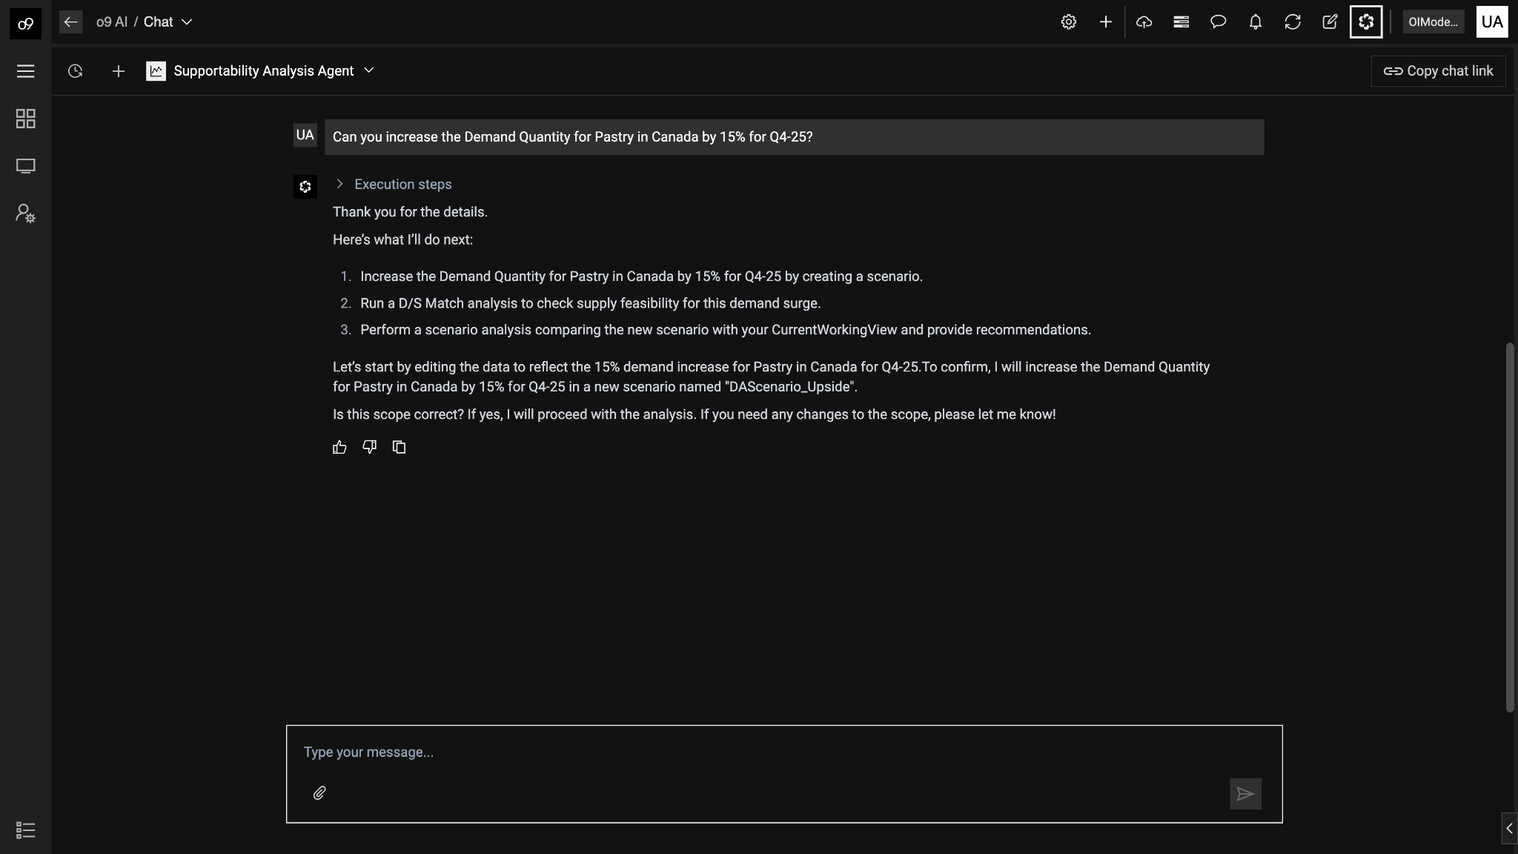
o9 PLATFORM | DEMO
Planner decides to evaluate a 15% demand upside for Pastry in Canada for the next quarter since there were no constraints towards the end of the quarter
Agent confirmation to ensure the right scope is provided by the user before any edit workflows are undertaken
Also, edits would be performed in a scenario

Slide 15
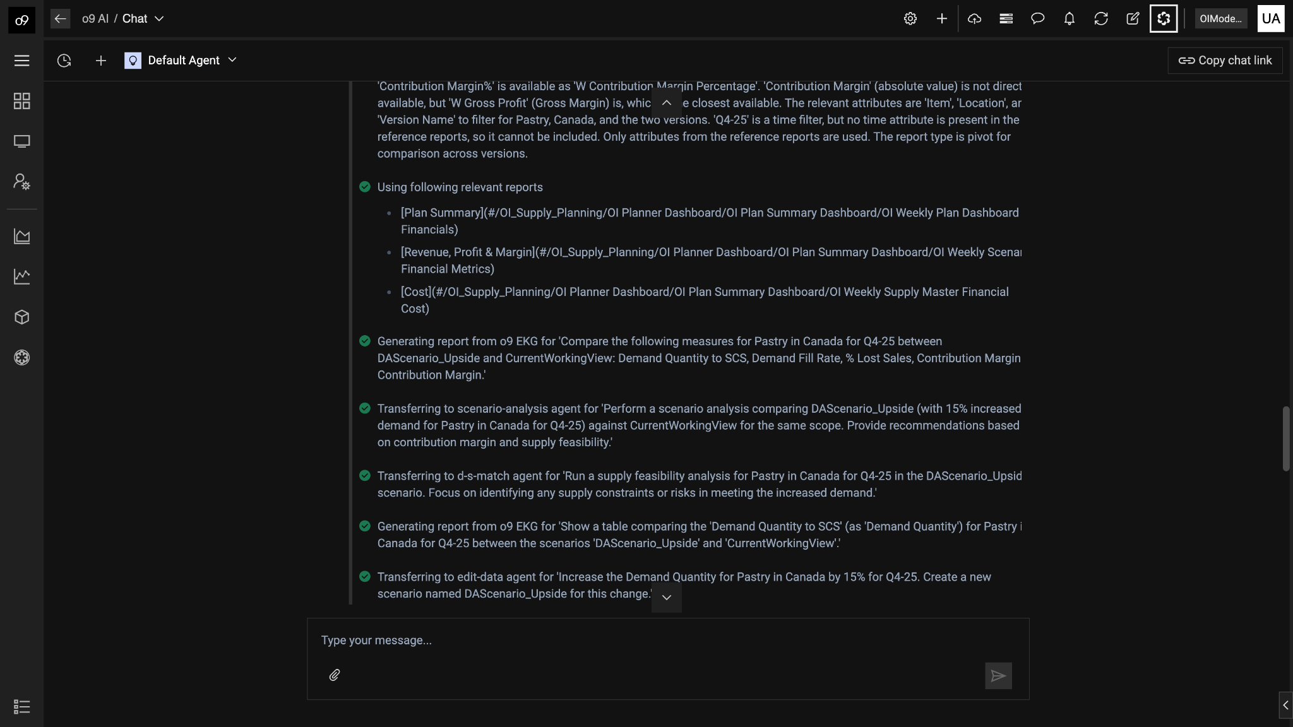
o9 PLATFORM | DEMO
Supportability agent is a specialized skill composite agent that invokes multiple atomic agents like edit data, run D/S match solver, etc to automate the analysis
Execution plan generated by the supportability analysis agent shows the reasoning and invocation of multiple agents to accomplish the task
Sequence includes
Edit data
Generate report
Run D/S Match Solver
Plan analysis to compare scenarios
Generate report of scenario comparison
Recommendations

Slide 16
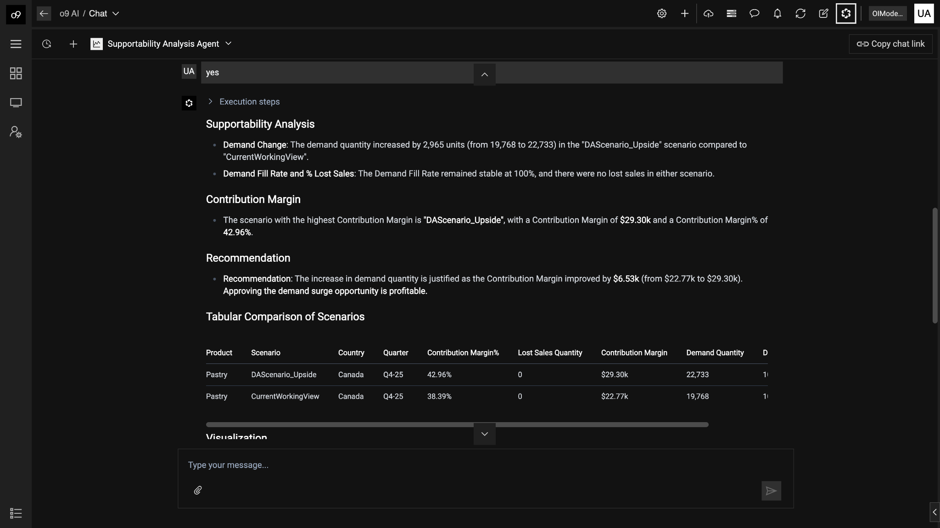
o9 PLATFORM | DEMO
Supportability analysis agent recommends that the demand upside is still profitable to consider based on increased contribution margin
Recommendation is that the demand upside is still profitable to consider based on increased contribution margin

Slide 17
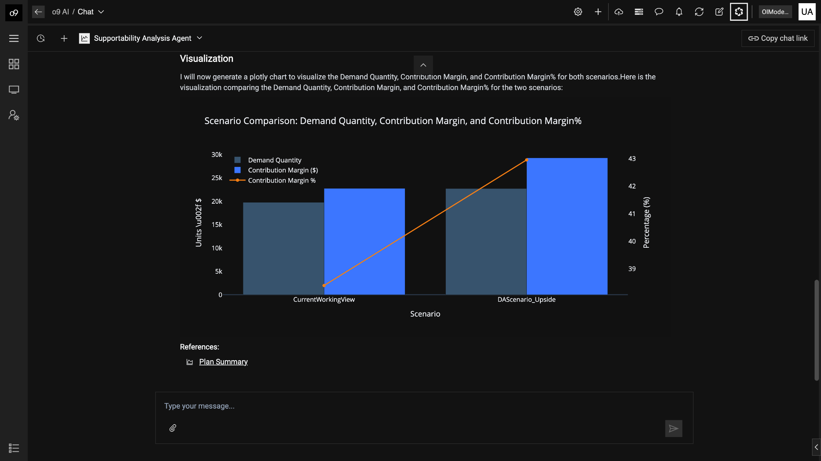
o9 PLATFORM | DEMO
Planner decides to get detailed insights into the recommendation and contextually navigated to see the scenario comparison reports
Live links to relevant reports used by the agents for the user to continue their detailed analysis

Slide 18
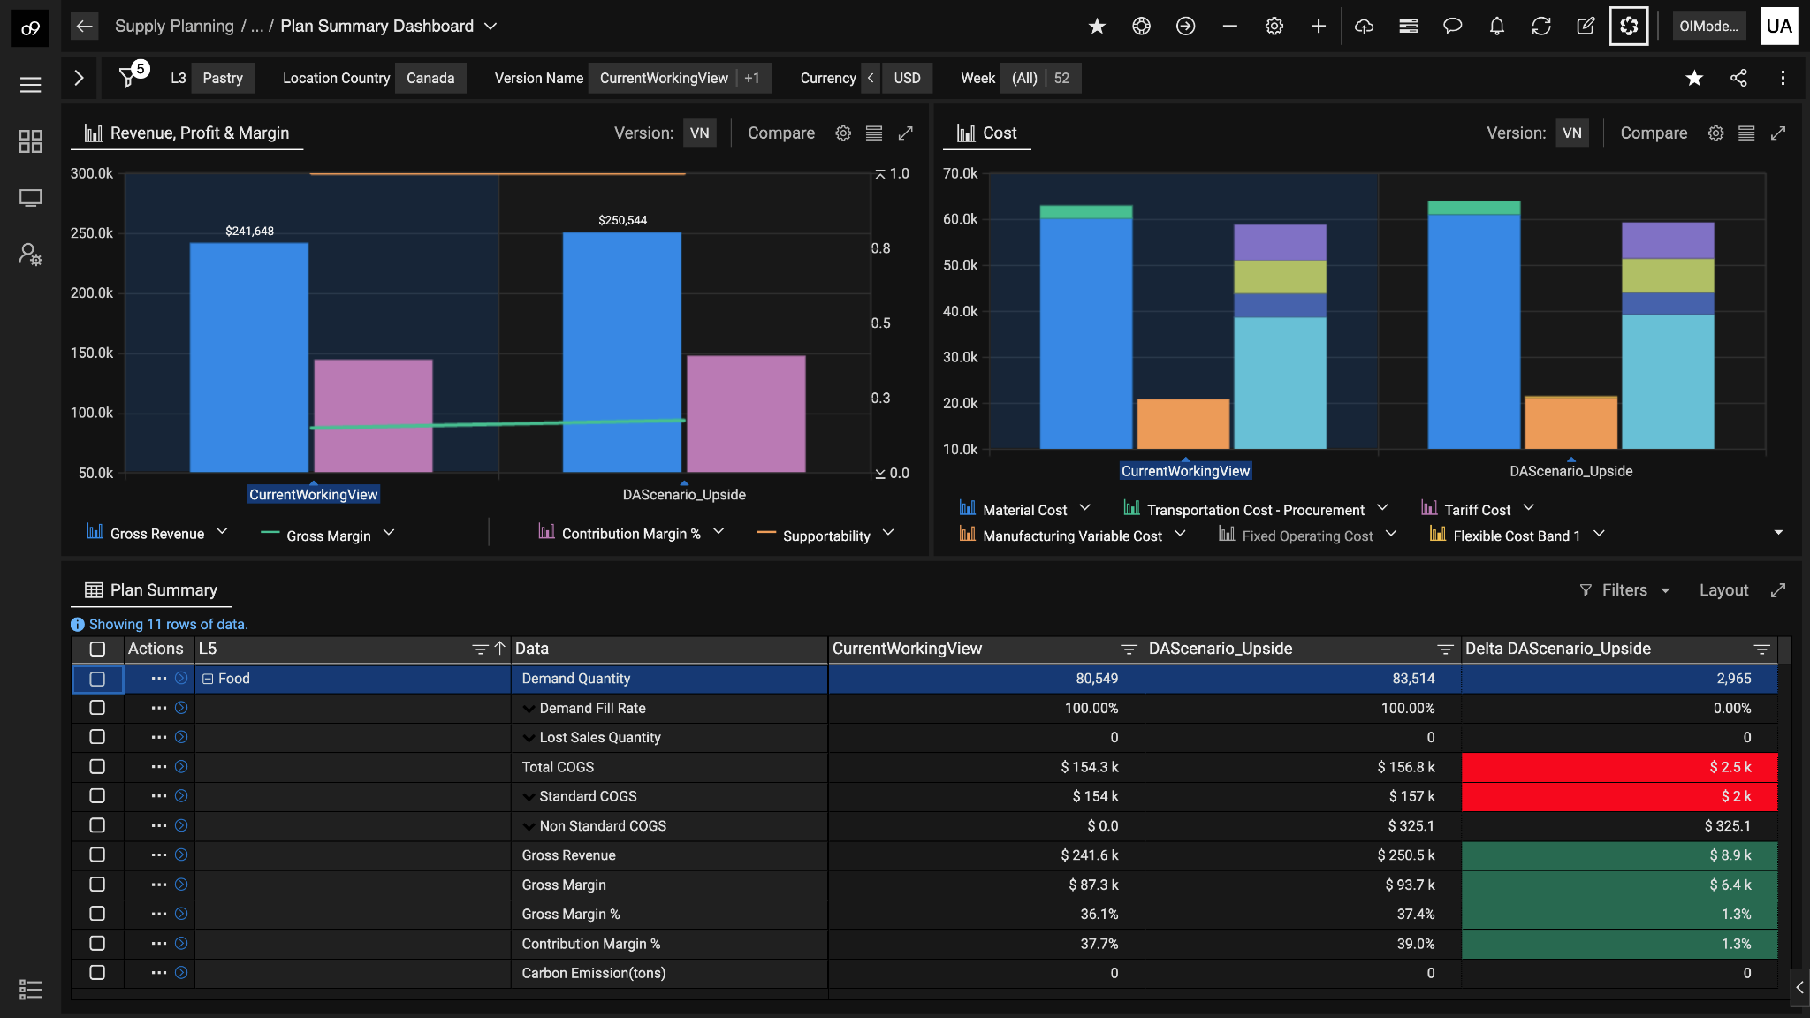
o9 PLATFORM | DEMO
Planner navigates to the scenario comparison report that shows a detailed comparison of the demand upside scenario for further analysis
Details of various KPIs used for financial impact analysis of the supply response

Slide 19
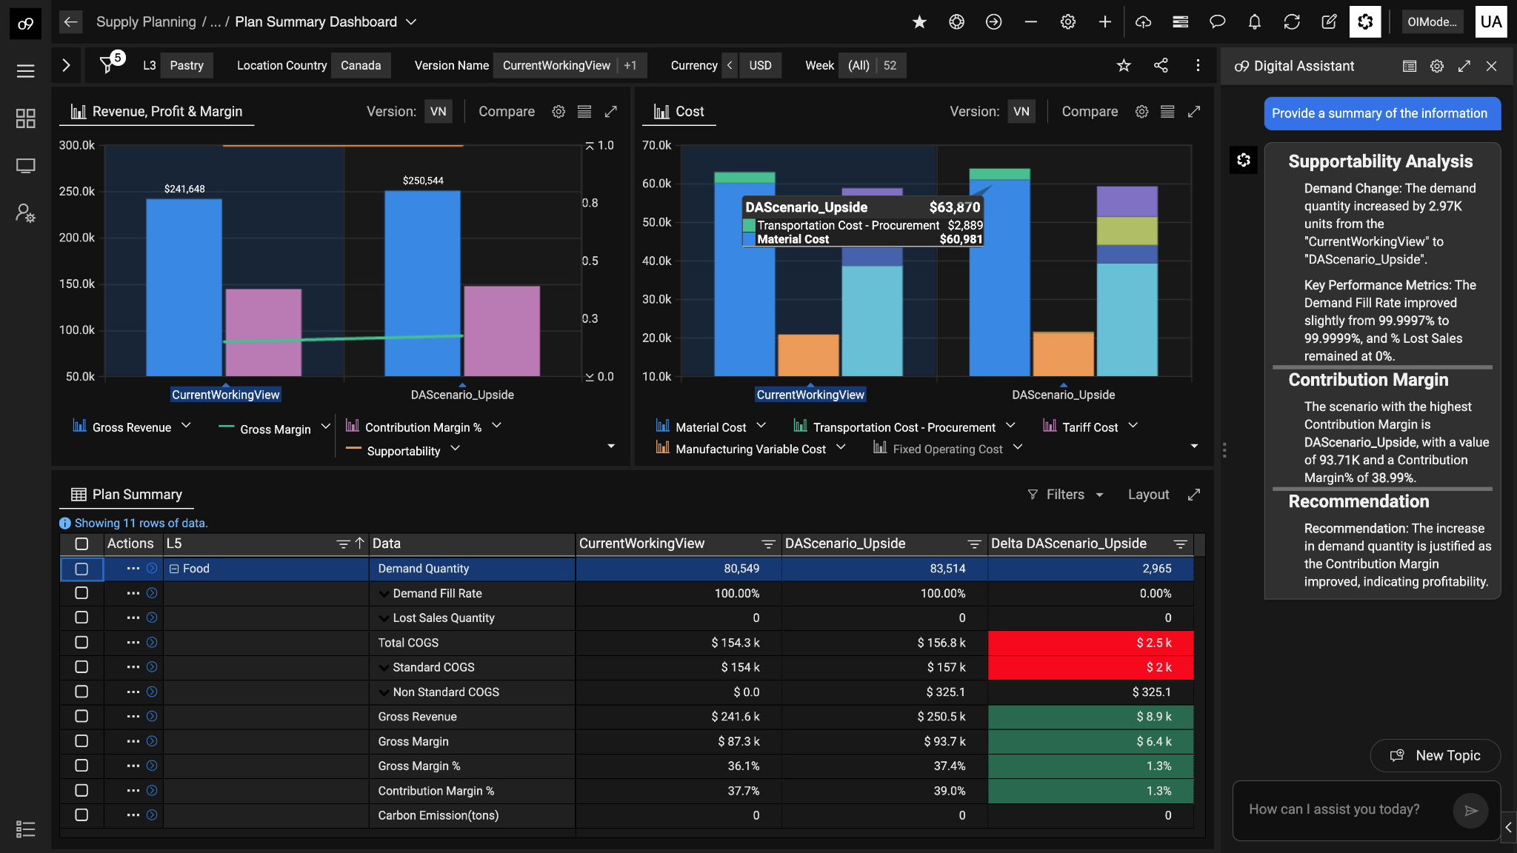
o9 PLATFORM | DEMO
Planner can use live narration of any report in the system to summarize the report as instructed and trained by an expert
Contextual digital assistant to support report narration and operator functions

Slide 20

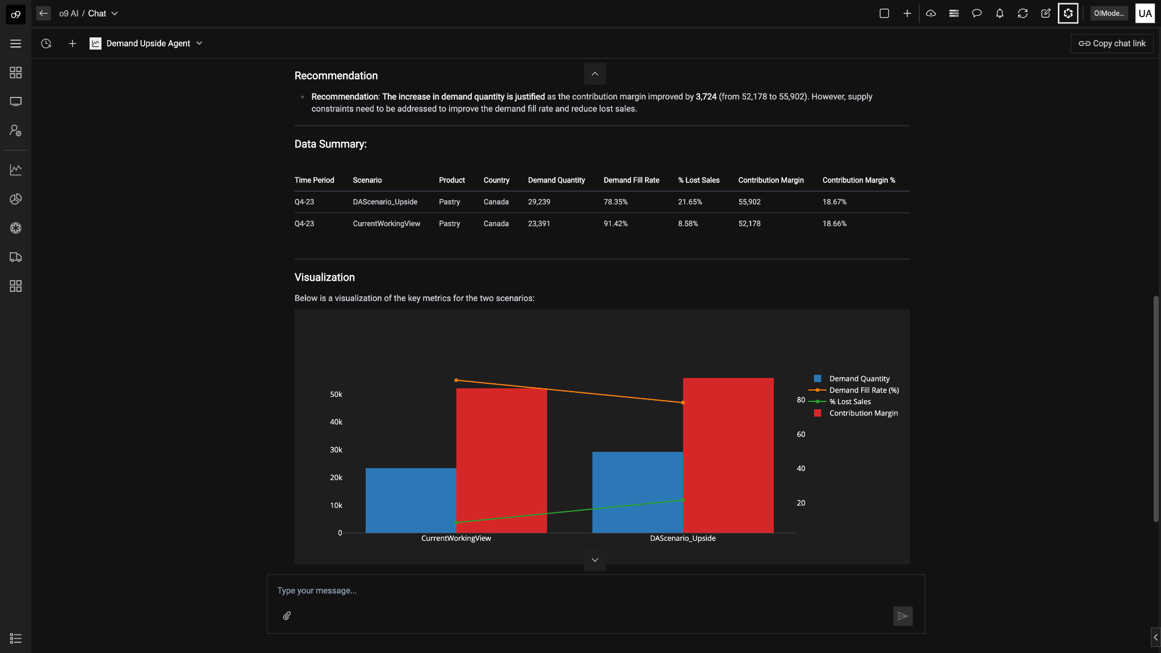
With o9
Amplifying Agility with AI-powered Scenario Planning
o9 PLATFORM | DEMO
SUMMARY
R&O agents to detect Risks & Opportunities earlier and propagate them in real-time
Composite agents for automating complex tasks to evaluate demand upside scenarios driving productivity across the organization
Expert plan analysis agents driving coordinated, financially smarter responses

Slide 21
o9 PLATFORM | DEMO
2025
Thank you.

